Slide 1
Silverlight
Ivaylo Bratoev
Telerik Corporation
www.telerik.com

Slide 2
What is Silverlight?
Microsoft web-based platform for building and running RIAs based on .NET Framework
RIA?!?
Rich Internet Applications (Adobe)
Rich Interactive Applications (Microsoft)
Cross platform – Windows, Mac, Linux (Moonlight)
Cross browser – Internet Explorer, Firefox, Chrome, Safari, Opera, etc…

Slide 3
What is Silverlight?
Similar to Flash/Flex
Supports video and audio playback and streaming
Designed for .NET
Managed code using any .NET language – CLR, VB.NET, IronPython, IronRuby
Easy integration with other .NET technologies – ASP.NET, LINQ, etc.

Slide 4
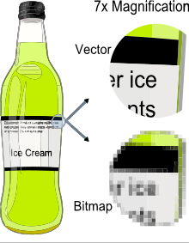
Vector Graphics

Slide 5
Versions
1.0 (2007) - First version.
No managed code, uses JavaScript for manipulating GUI elements
2.0 (2008)
Supports managed code. Based on .NET 3.5
Rich base class library - subset of the full .NET Framework
Deep Zoom

Slide 6
Versions
3.0 (2009)
Out-of-browser functionality
Hardware acceleration for video and bitmaps
4.0 (2010)
Printing
Webcam, Microphone

Slide 7
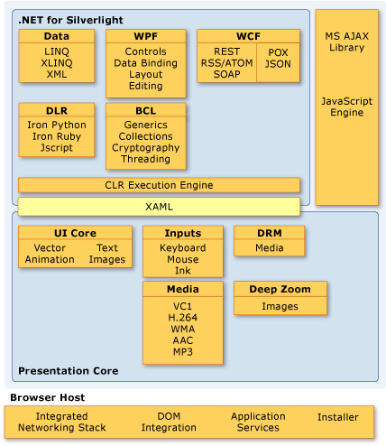
Architecture
Notes:
Core presentation framework:
Components and services oriented toward the UI and user interaction, including user input, lightweight UI controls for use in Web applications, media playback, digital rights management, data binding, and presentation features, including vector graphics, text, animation, and images. Also includes the Extensible Application Markup Language (XAML) for specifying layout.
.NET Framework for Silverlight:
A subset of the .NET Framework that contains components and libraries, including data integration, extensible Windows controls, networking, base class libraries, garbage collection, and the common language runtime (CLR).
Some parts of the .NET Framework for Silverlight are deployed with your application. These "Silverlight Libraries" are assemblies not included in the Silverlight runtime and are instead shipped in the Silverlight SDK. When Silverlight Libraries are used in your application, they are packaged up with your application and downloaded to the browser. These include new UI controls, XLINQ, Syndication (RSS/Atom), XML serialization, and the dynamic language runtime (DLR).
Installer and updater:
An installation and update control that simplifies the process of installing the application for first-time users, and subsequently provides low-impact, automatic updates.

Slide 8
Architecture
Lightweight browser plugin (3.0 is 3.7MB)
Subset of .NET Framework – only components that are needed in a client application
Execution Engine
Based on CLR – executes the managed code
Security, Memory Management,
Loads in the Silverlight plugin
Very small size

Slide 9
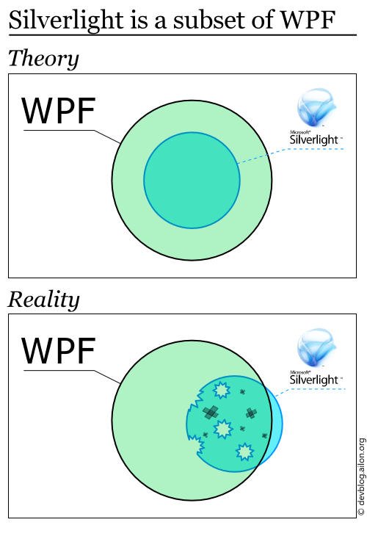
Silverlight and WPF

Slide 10
Development Tools
Visual Studio 2010 – SL 3.0, 4.0
Visual Studio 2008 – SL 3.0
Expression Blend 3.0/4.0

Slide 11
XAML
Extensible Application Markup Language
Declarative XML based language
A hierarchy of elements representing visual objects (UI elements)
Elements -> CLR objects – classes and structures
Attributes -> CLR properties and events

Slide 12
Demo: XAML Basics

Slide 13
CLR Objects
<!– XAML Code -->
<Button Content="Hello World“ />
// C# Code
Button b = new Button()
{
Content = “Hello World“
};

Slide 14
CLR Attributes
Object properties are set
<Button Content="Hello World“ />
<Button>
<Button.Content>
Hello World
</Button.Content>
</Button>

Slide 15
Type Converters
Background type – SolidColorBrush
<Button Content="Hello World“ Background=“Blue“ />
// C# Code
Button b = new Button()
{
Content = “Hello World“;
Background= “Blue”; // error
};

Slide 16
Type Converters
Run-time SolidColorBrush is converted to String
<Button>
<Button.Background>
<SolidColorBrush Color="Blue"/>
</Button.Background>
<Button.Content>
Hello world
</Button.Content>
</Button>

Slide 17
Markup Extensions
{…}
StaticResource
Binding
RelativeSource
<Button
Background="{StaticResource key}"
Content="{Binding actionButtonName}" Click="Button_Click“ />

Slide 18
Events and XAML Code-Behind
<Button Content="Hello World"
Width="75"
Margin="52,0,0,48" Click="Button_Click"/>
private void Button_Click(object sender,RoutedEventArgse)
{
MessageBox.Show("Hello World");
}

Slide 19
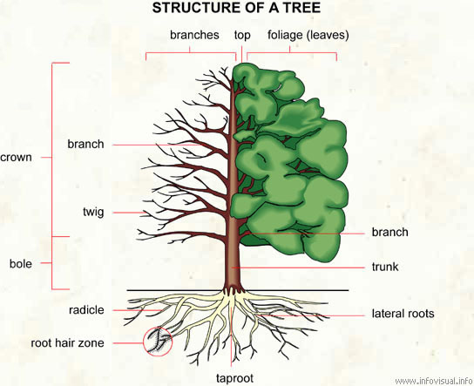
Visual Tree

Slide 20
Visual Tree
Contains all visual elements
Defines the elements hierarchy
Major part of the rendering mechanism
RoutedEvents use the Visual Tree
VisualTreeHelper – helper methods to traverse the Visual Tree

Slide 21
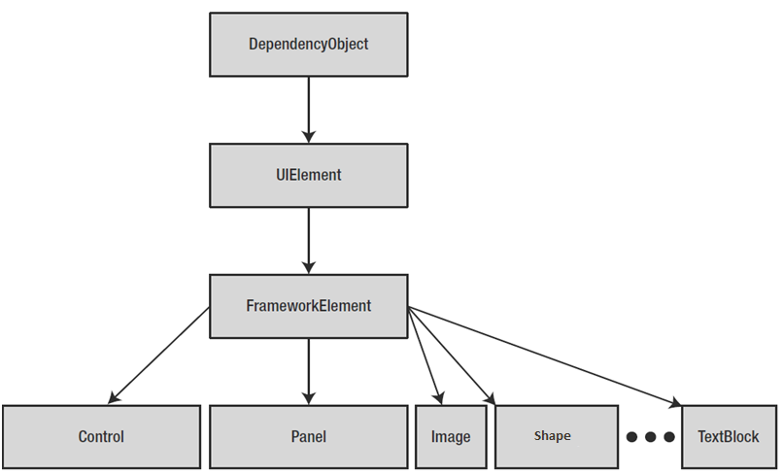
Base Classes

Slide 22
Base Classes
DependecyObject
Dependency properties (SetValue, GetValue, etc.)
Synchronization (Dispatcher)
UIElement – визуален елемент
Rendering (RenderTransform, Effect, …)
Layout (Measure,…)
Routed events (AddHandler, RemoveHandler)
User interaction (MouseEnter, MouseLeave,…)

Slide 23
Base Classes
FrameworkElement
Custom layout (MeasureOverride, ArrangeOverride, Width, Height, etc.)
Lifetime events (Loaded, Unloaded, etc.)
Bindings (SetBinding, DataContext, etc.)
Panel
Children
Background

Slide 24
Base Classes
Control
Appearance (Background, BorderBrush, etc.)
Focus management (Focus, IsTabStop, etc.)
Control templates & default Style key
ContentControl
Content support (Content, ContentTemplate, etc.)
ItemsControl
Items support (Items, ItemsSource, etc.)

Slide 25
Layout
Panels
Visual elements
0, 1 or more children
Layout logic (how to position the children)
Branches in the Visual Tree

Slide 26
Canvas
Simple panel with absolute coordinates and sizes
Attached Properties
Canvas.Left
Canvas.Top
Canvas.ZIndex

Slide 27
StackPanel
Simple logic – stacking
No attached properties
Only configuration – Orientation:
Horizontal
Vertical

Slide 28
Grid
Very powerful panel
Similar to a table
Definitions
RowDefinitions
ColumnDefinitions
GridLenght – star (*), absolute, auto

Slide 29
Demo: Calculator

Slide 30
Silverlight Layout System
It takes care to position the VisualTree elements on the screen
Measure – desired size is determined
Arrange – element size and position are finalized

Slide 31
Sizing
Width, Height
MinWidth, MinHeight
MaxWidth, MaxHeight
Margin
Padding

Slide 32
Margin vs Padding
Layout slot
Padding
Element content area
Element area
Margin

Slide 33
Alignment
VerticalAlignment – Top, Center, Bottom, Stretch
HorizontalAlignment – Left, Center, Right, Stretch
Content
VerticalContentAlignment
HorizontalContentAlignment

Slide 34
Demo: Sizing and Allignments

Slide 35
Silverlight
Notes:
Special Thanks to http://fmi.silverlight.bg/ for some of the demos/slides.
You can find more detailed tutorials there.

